Slide 1
2
Thinking Like an Economist

Slide 2

Figure 1 The Circular Flow
MARKETS
Revenue
FOR
Spending
GOODS AND SERVICES
Goods
Firms sell
Goods and
and services
Households buy
services
sold
bought
FIRMS
HOUSEHOLDS
Produce and sell
Buy and consume
goods and services
goods and services
Hire and use factors
Own and sell factors
of production
of production
Factors of
MARKETS
Labour, land,
production
FOR
and capital
FACTORS OF PRODUCTION
Wages, rent,
Households sell
Income
and profit
Firms buy
= Flow of inputs
and outputs
= Flow of euros
Copyright © 2004 South-Western

Slide 3
Figure 2 The Production Possibilities Frontier
Quantity of
Computers
Produced
3,000
D
2,200
C
2,000
A
Production
possibilities
B
frontier
1,000
0
300
600
700
1,000
Quantity of
Cars Produced
Copyright©2003 Southwestern/Thomson Learning

Slide 4
Figure 3 A Shift in the Production Possibilities Frontier
Quantity of
Computers
Produced
4,000
3,000
2,100
E
2,000
A
0
700
750
1,000
Quantity of
Cars Produced
Copyright © 2004 South-Western

Slide 5

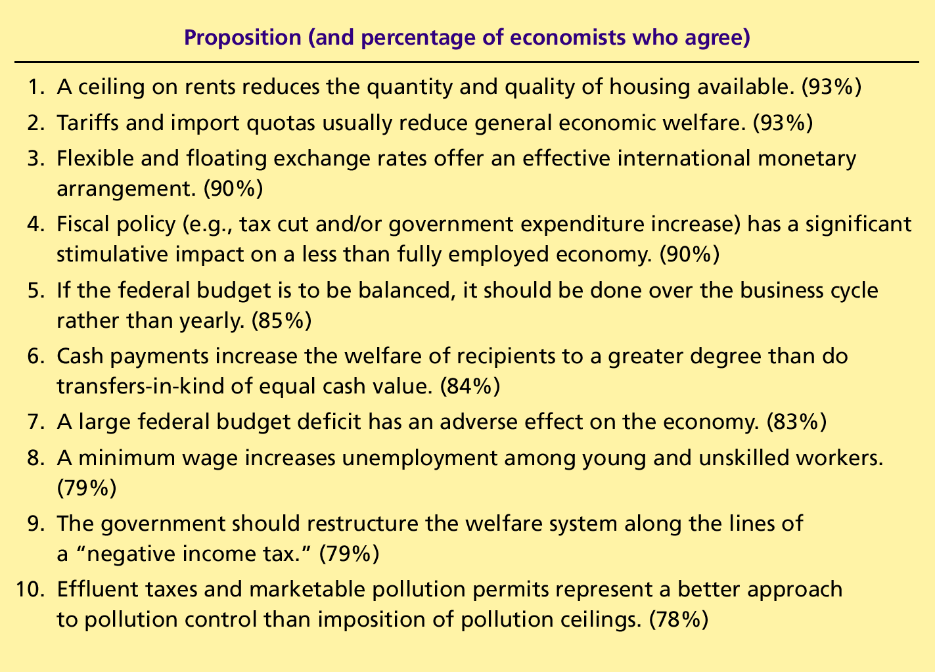
Table 2 Ten Propositions about Which Most Economists Agree
Copyright © 2004 South-Western

